Slide 1
SINET6 DDoS Mitigation Service
Naoya Kitagawa
National Institute of Informatics (NII), Japan
June 26-27, 2023

Slide 2



Automatic DDoS Mitigation Service
Launched a new service that automatically detects and prevents DDoS attacks
  Operation as an official service started in January 2023
  Deployed a DDoS attack detection function within SINET
  Register IP addresses for attack detection based on service registrations
  Real-time DDoS attack detection and alerting
    Packet filter configurations can be automatically set about 10 seconds after an attack is detected (Under development)
NEW！
Conventional Mitigation Service
New Mitigation Service
Need more than several hours from application to completion of packet dropping setup
Approx. 10 seconds from attack detection to completion of packet dropping configuration
❶ DDoS attack detection
❷ Application for mitigation
❸ Configure packet drop settings on the RR
❹ Configure filter settings on the routers
❶ Service Application (Target IP Address Registration)
❷ Information collection
❸ DDoS attack detection
❹ Configure filter settings on the routers
❸
SINET Reception Desk
SINET Reception Desk
DDoS Mitigation Service
❸
Operator
❷
RR
Operator
❶
❹
❶
❷
❹
❶
❹
Institution
Router
Router
Internet
Institution
Router
Internet

Slide 3
System Components
NTD
  The main element of the system that performs DDoS Attack detection on mirrored packets received from routers
  No direct manipulation of NTD in the system in operation
  No GUI; status is referenced via CMS
CMS
  Central Management System
  Used to change attack detection thresholds, change operation mode (Monitor, Mitigate), and manage system-wide alerts
SWA
  Provides GUI operation and information reference for this system
  Display the control status of the system, traffic graphs (pass/monitor/block),
  and attack information
  Provides IP address registration of the router to be controlled
SSP
  User portal
  Creates tenants and tenant administrator accounts
  Browses graphs and attack information for all created tenants

Slide 4


Test System Configuration
Private segment for server operation
ssh
eno3
GUI (CMS)
enp3s0f0
GUI (SWA)
Jump Server
enp11s0f0
master server
(HPE ProLiant
DL360 Gen 10)
eno2
DDoS Mitigation System
Not connected
(reserve)
ssh
VM
(vCMS)
VM
(vSWA)
VM
(vNTD)
KVM
SINET
NAT
(ip masquerade)
macvlan0
PCI passthrough
Internet
eno4
eno1
eno5
eno6
(10G)
(10G)
management
mirrored
mirrored
Remote Control
(SSH, http, https)
eno1
xe-5/2/0
eno1
hping1
1G
xe-7/0/0
1G
hping2
eno2
enp1s0f0
xe-5/0/0
nii-RM1
(MX960)
enp1s0f0
eno2
nii-RM2
(MX960)
.201
dummy traffic generation server
(hping1 as source)
xe-5/0/1
dummy traffic generation server
(hping2 as target)
ex4300
ex4300
(←same as
ex4300)
Actual traffic
(Mirror input)
nii-RM3
(MX480)

Slide 5
Test System Configuration (cont’d)
DDoS Mitigation System
VM
(vNTD)
VM
(vCMS)
VM
(vSWA)
telemetry (Statistics collection)
xe-1/1
xe-1/2
Netconf (Filter setting/cancellation)
NII traffic
eno5
eno6
telemetry
netconf
Mirror
nii-RM1
(MX960)
nii-RM2
(MX960)
xe-5/2/0
et-5/1/0
et-5/1/0
xe-7/0/1 (9/7 add)
xe-5/0/1
mirrored
mirrored
hping2
hping1
et-7/1/0
et-7/1/0
xe-5/0/0
xe-7/0/0
et-5/3/0
(down)
et-5/3/0
(down)
et-7/3/0
ex4300
et-7/3/0
ex4300
Mirror xe-5/0/0 and
xe-5/0/1 to xe-5/0/2
et-4/1/0
(down)
et-4/3/0
(down)
et-5/1/0
nii-RM3
(MX480)
et-5/3/0

Slide 6
Processing flow in monitor mode
※ Router ->NTD mirroring is omitted.
telemetry packet (for Firewall filter)
user data packet (DDoS attacks)
hping1
Router (nii-RM1)
hping2
SWA
CMS
telemetry
Operation mode setting
(Monitor mode)
Transmission Start
(hping3 execution)
1send/sec
TCP SYN floods
15-20 secs.
Detect the attack
netconf
Set up
additional filter
Stop Transmission
(hping3 stop)
Continues to receive
packets after attack
detection
Filter is applied and only
monitoring is performed
Approx. 5 minutes
since last transmission
...
netconf
Filter Release Setting

Slide 7
Processing flow in mitigation mode
※ Router ->NTD mirroring is omitted.
telemetry packet (for Firewall filter)
user data packet (DDoS attacks)
hping1
Router (nii-RM1)
hping2
SWA
CMS
telemetry
Operation mode setting
(Mitigation mode)
Transmission Start
(hping3 execution)
1send/sec
TCP SYN floods
15-20 secs.
Detect the attack
netconf
Block packet reception
upon attack detection
Set up
additional filter
Stop Transmission
(hping3 stop)
Packets are discarded
by the filter
Approx. 5 minutes
since last transmission
...
netconf
Filter Release Setting

Slide 8
Example of automatic config submission to router (monitor)
Before TCP SYN flood transmission starts
Start sending TCP SYN flood → After attack detection
{master}
nii@nii-RM1> show ephemeral-configuration ddmon
## Last changed: 2020-07-21 17:52:26 JST
firewall {
family inet {
filter DDMON-MITIGATE {
term egress_manual {
then next term;
}
term discard_manual {
then next term;
}
term discard_auto {
then next term;
}
term accept_manual {
then next term;
}
term accept_auto {
then next term;
}
}
}
}
{master}
nii@nii-RM1>
{master}
nii@nii-RM1> show ephemeral-configuration ddmon
## Last changed: 2020-07-21 19:13:06 JST
firewall {
family inet {
filter DDMON-MITIGATE {
term egress_manual {
then next term;
}
term discard_manual {
then next term;
}
term discard_auto {
then next term;
}
term accept_manual {
then next term;
}
term e47a37ac4dc5a630bd7fc1f16d129f22-match {
from {
destination-address {
202.241.0.1/32;
}
packet-length 128-255;
protocol tcp;
ttl 64-127;
destination-port 1111;
tcp-flags "!fin & syn & !rst & !psh & !ack";
}
then {
count Corero-auto-e47a37ac4dc5a630bd7fc1f16d129f22-match;
port-mirror;
next term;
}
}
term e47a37ac4dc5a630bd7fc1f16d129f22-action {
from {
destination-address {
202.241.0.1/32;
}
packet-length 128-255;
protocol tcp;
ttl 64-127;
destination-port 1111;
tcp-flags "!fin & syn & !rst & !psh & !ack";
}
then {
count ddmon-auto-e47a37ac4dc5a630bd7fc1f16d129f22-accept;
accept;
}
}
term accept_auto {
then next term;
}
}
}
}
{master}
nii@nii-RM1>
netconf
Automatically submitted from SWA to router
(by netconf)
Stop sending TCP SYN flood → After filter is released
{master}
nii@nii-RM1> show ephemeral-configuration ddmon
## Last changed: 2020-07-21 19:21:05 JST
firewall {
family inet {
filter DDMON-MITIGATE {
term egress_manual {
then next term;
}
term discard_manual {
then next term;
}
term discard_auto {
then next term;
}
term accept_manual {
then next term;
}
term accept_auto {
then next term;
}
}
}
}
{master}
nii@nii-RM1>
netconf
“Accept" is set for monitor mode

Slide 9
Example of automatic config submission to router (mitigate)
Before TCP SYN flood transmission starts
Start sending TCP SYN flood → After attack detection
{master}
nii@nii-RM1> show ephemeral-configuration ddmon
## Last changed: 2020-07-21 19:21:05 JST
firewall {
family inet {
filter CORERO-MITIGATE {
term egress_manual {
then next term;
}
term discard_manual {
then next term;
}
term discard_auto {
then next term;
}
term accept_manual {
then next term;
}
term accept_auto {
then next term;
}
}
}
}
{master}
nii@nii-RM1>
{master}
nii@nii-RM1> show ephemeral-configuration ddmon
## Last changed: 2020-07-21 19:24:11 JST
firewall {
family inet {
filter DDMON-MITIGATE {
term egress_manual {
then next term;
}
term discard_manual {
then next term;
}
term e47a37ac4dc5a630bd7fc1f16d129f22-match {
from {
destination-address {
202.241.0.1/32;
}
packet-length 128-255;
protocol tcp;
ttl 64-127;
destination-port 1111;
tcp-flags "!fin & syn & !rst & !psh & !ack";
}
then {
count Corero-auto-e47a37ac4dc5a630bd7fc1f16d129f22-match;
port-mirror;
next term;
}
}
term e47a37ac4dc5a630bd7fc1f16d129f22-action {
from {
destination-address {
202.241.0.1/32;
}
packet-length 128-255;
protocol tcp;
ttl 64-127;
destination-port 1111;
tcp-flags "!fin & syn & !rst & !psh & !ack";
}
then {
count ddmon-auto-e47a37ac4dc5a630bd7fc1f16d129f22-discard;
discard; ★
}
}
term discard_auto {
then next term;
}
term accept_manual {
then next term;
}
term accept_auto {
then next term;
}
}
}
}
{master}
nii@nii-RM1>
Automatically submitted from SWA to router
(by netconf)
netconf
Stop sending TCP SYN flood → After filter is released
{master}
nii@nii-RM1> show ephemeral-configuration ddmon
## Last changed: 2020-07-21 19:31:42 JST
firewall {
family inet {
filter CORERO-MITIGATE {
term egress_manual {
then next term;
}
term discard_manual {
then next term;
}
term discard_auto {
then next term;
}
term accept_manual {
then next term;
}
term accept_auto {
then next term;
}
}
}
}
{master}
nii@nii-RM1>
netconf
discard" is set for mitigation mode

Slide 10
Service Configuration
ssh
eno3
enp3s0f0
corero-master
(HPE ProLiant DL360 Gen 10)
(CMS) https://192.168.0.201
(SWA) https://192.168.0.202:8000
(SSP) https://192.168.0.204
Jump Server
enp11s0f0
DDoS Mitigation System
ge-0/0/13
eno2
ssh
Incoming telemetry packets (30000/udp) to SWA
VM
(vSSP)
VM
(vCMS)
VM
(vSWA)
VM
(vNTD)
telemetry
netconf
KVM
Remote Control
(SSH, http, https)
Incoming 443/tcp packets to vSSP (for access to SSP)
PCI passthrough
NAT
(ip masquerade)
macvlan0
eno4
eno1
eno5
eno6
SINET
(10G)
(10G)
xe-0/2/0
(untag)
disabled
et-9/0/2.0
100G
tokyo1-GM
Mirror
(1:1000)
vlan300
mirrored
xe-4/0/0.0
ae4.0
20G
ge-0/0/21
Mirror
(1:1000)
ex4300
tokyo1-GM2
nii-RM1
(MX960)
nii-RM3
(MX480)
nii-RM2
(MX960)
xe-1/0/0:1.400
ae2.1002
200G
mirrored

Slide 11
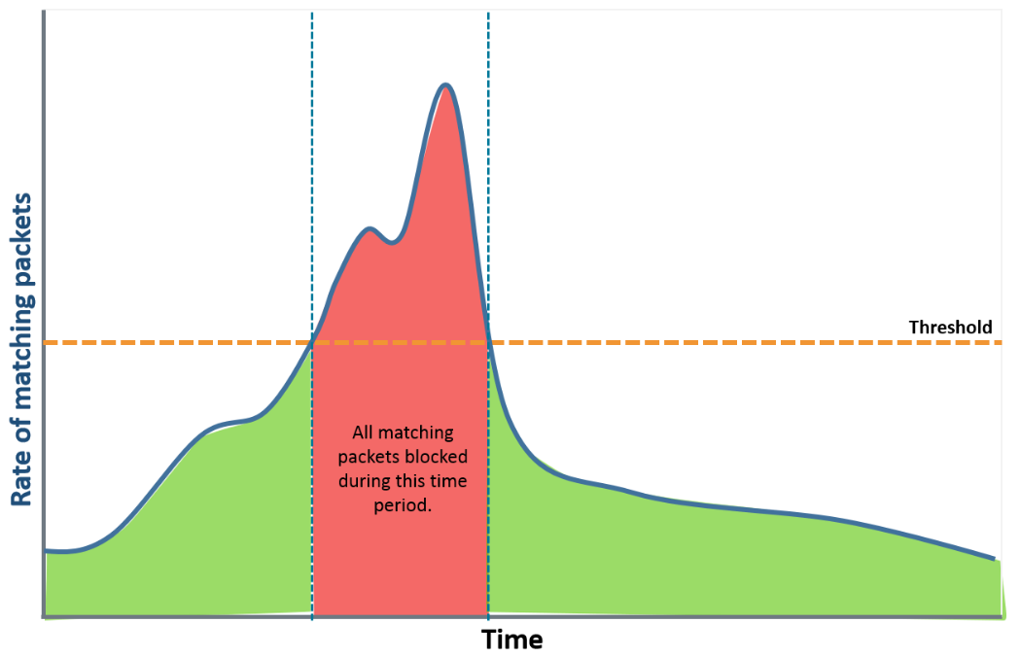
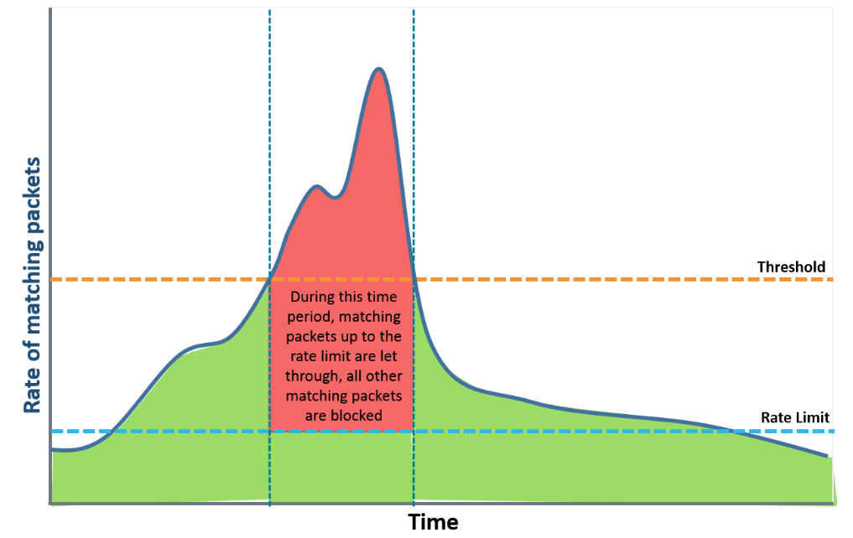
Threshold and Rate Limit
Two types of parameters for each detection rule: “Threshold” and “Limit”
  Packet Threshold (pps), Bit Threshold (bps)
    Rule application threshold (traffic matching the condition and exceeding the threshold is subject to detection)
  Packet Rate Limit (pps), Bit Rate Limit (bps)
    Allowable rate of transit for rule-matching traffic (even detection targets are allowed to pass up to a certain amount)
If the traffic matching the condition exceeds the threshold, all such traffic is subject to blocking.
Only the amount exceeding the rate limit is blocked.
Allowed up to Rate limit even if detection condition is met.
pps or bps
pps or bps
Threshold
Threshold
Rate Limit

Slide 12
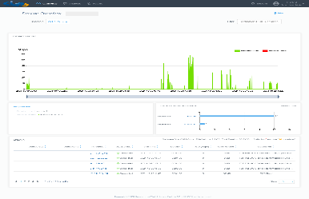
Confirmation of Attack Detection Results
Institution's administrators can access the service portal to view real-time attack detection results from the DDoS Mitigation service
Service Portal
Access with browser
Real-time DDoS attack detection
Automatic filter for DDoS attacks
Monitoring
Results
DDoS Mitigation
System
Administrator 1
(Tenant Admin)
Administrator 2
(Tenant User)
Monitor
Control
Control
...
Monitor
The Internet
University/Institution
SINET

Slide 13
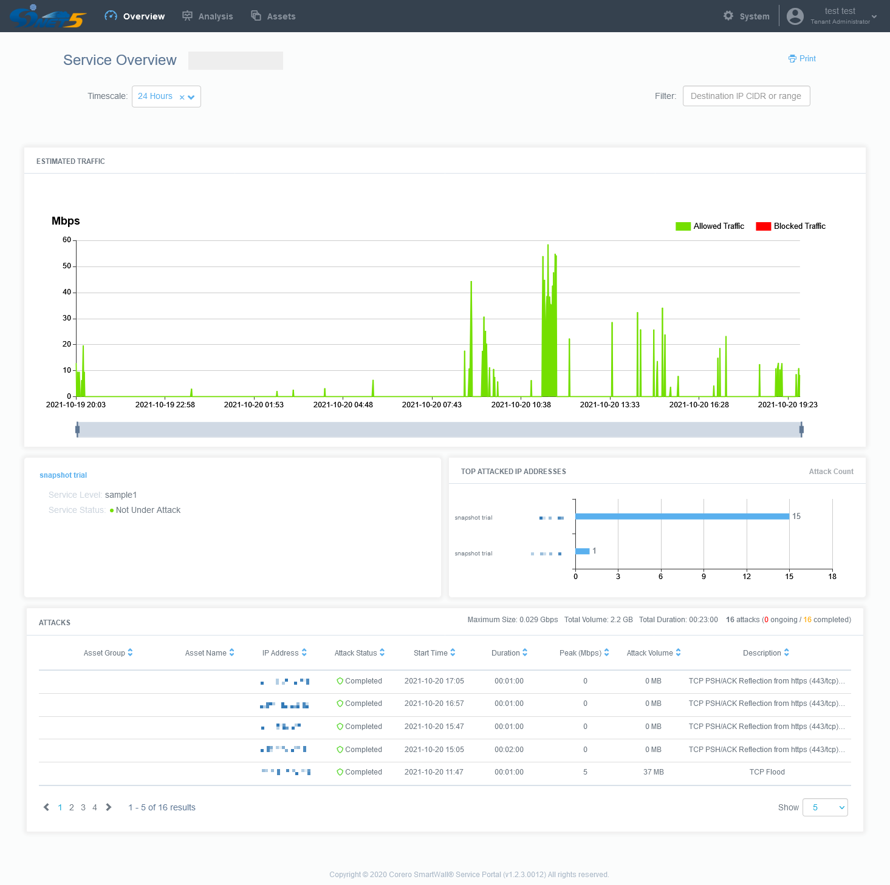
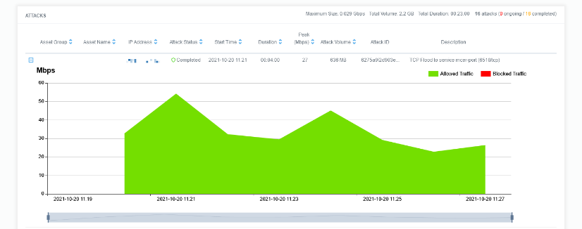
Information available on the portal site
Graphical display of traffic volume
  Graph of the amount of traffic received by each institution's network over time
  Graphical display of the amount of discarded DDoS attack traffic is also supported
Display of IP addresses of frequent attack targets
  Ranking of the most frequently attacked IP addresses in the institution's network
List of detected attacks
  List of detected DDoS attacks
  Target IP address of attack, detection period, amount of detected traffic, etc.
・Browser-based information display
・E-mail report function
・Login User Management
Traffic amount
IP addr. of frequent targets
Graph of traffic volume for each attack
xxx.xxx.xxx.xx
List of detected attacks
xxx.xxx.xxx.xx
x.x.x.x
xxx.xxx.xxx.xx
xxx.xxx.xxx.xx
xxx.xxx.xxx.xx
xxx.xxx.xxx.xx
xxx.xxx.xxx.xx

Slide 14
Overview
Provides traffic graph and attack detection list
Narrow down the time period to display
（ Last 24 hours by default）
Narrow down the display target
by entering CIDR
Traffic Volume Graph
Automatically blocked attack traffic
volume can also be displayed
(Automatic block control is under development)
Detection Status
(Under Attack or not, etc.)
xxx.xxx.xxx.xx
xxx.xxx.xxx.xx
IP address ranking of attack targets
AAA学部
XX研究室
xxx.xxx.xxx.xx
List of detected attacks
(Target IP address, date and time of the attack, reason for detection, etc.)
AAA学部
XX研究室
xxx.xxx.xxx.xx
AAA学部
YY研究室
xxx.xxx.xxx.xx
AAA学部
YY研究室
xxx.xxx.xxx.xx
BBBグループ
ZZセンター
xxx.xxx.xxx.xx

Slide 15
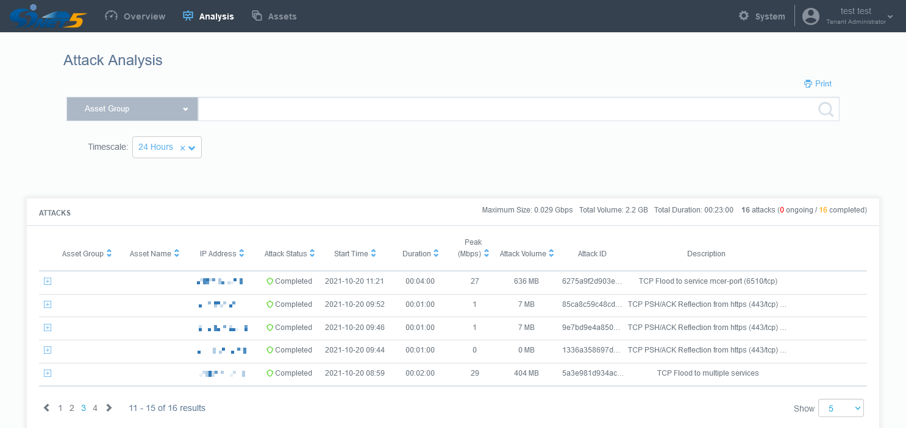
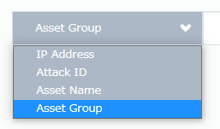
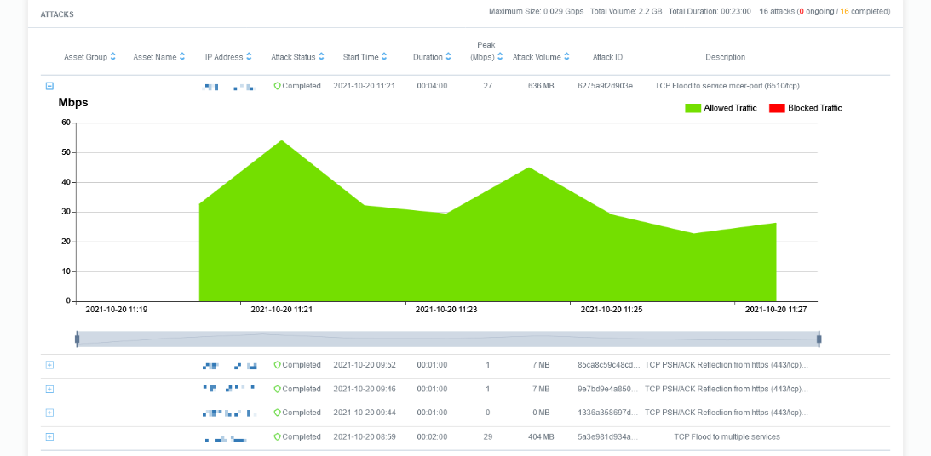
Analysis
Provides information on detected DDoS attacks
Traffic graphs for individual attacks can be viewed
Print (Browser function)
Narrow down the time period to display
（ Last 24 hours by default）
Click the "+" icon from the attack list to display the traffic graph
Narrow down the attack detection results to be displayed
・IP address
IP address of the attack target
・Attack ID
ID for attack identification
・Asset Name
Subnet name as defined by the institution's admin
・Asset Group
Subnet group name as defined by the institution’s
admin

Slide 16
Attack Detection List
Extracts and lists attack information for registered IP addresses
① IP addresses targeted by the attack
② Attack summary (TCP PSH/ACK Flood, UDP Reflection, etc.)
③ Services targeted by the attack (protocol, port number, etc.)
Asset Group | Asset Name | Target IP | Attack Status | Start time | Duration | Peak [Mbps] | Attack Volume | Description
Faculty of Engineering | Suzuki Lab. | 130.xx.xx.xx | Ongoing | 06/15/21 14:25:38 | 00:02:00 | 90 | 92GB | UDP Reflection from https (443/udp) to service 56xxx 57xxx
Faculty of Science | Sato Lab. | 130.xx.xx.xx | Completed | 06/15/21 11:10:05 | 00:01:00 | 37 | 19GB | TCP PSH/ACK Flood to service http-alt (8080/tcp)
1
2
3
Can be displayed with the actual group name if the administrator of
each institution registers the name in advance

Slide 17
Monitored CIDR management (Assets)
Institutional administrators can further subdivide the applied network addresses and name or group the divided address blocks
The network segment to which the IP address under attack belongs can be displayed and sorted on the “Overview” and “Analysis” screens using the defined name
日時指定(From,To)で
表示期間絞り込み可能
(※デフォルトは直近24時間指定)
CIDRで表示対象絞り込み可能
(Example)
Registered CIDR
192.168.0.0/16
Asset Name
Asset Group
192.168.1.0/24
Sato Lab.
Fac. of Eng.
192.168.2.0/24
Suzuki Lab.
Fac. of Sci.
192.168.3.0/24
XTZ Center
ABC Group
Other than above
(Undefined)
(No Name)
(No Name)

Slide 18
Conclusion and Future Tasks
<Conclusion>
DDoS Mitigation Service was launched as an official service in January 2023 after operational verification
29 institutions are using the new service, as of June 25, 2023
Currently in development to add packet drop function, which will be available upon completion
<Future Tasks>
Considering a method to evaluate the attack detection accuracy of the system
  It is difficult for us to know if detected attacks were actually observed at each institution
  Get feedback on regular user surveys?
Tuning of attack detection thresholds and their maintenance is not easy, since the line bandwidth of institutions connected to SINET range from ~1G to 400G
  Set several thresholds for each line bandwidth institution
  → Need to adjust while continuously checking attack detection status

